Slide 1
Document Analysis Practice
Learning the soap method

Slide 2
The “S” in SOAP: Speaker
This is when you identify who the speaker or artist is and why that role is important in terms of the document.
The author is _____________ ...
  CORNPEG
  Class
  Occupation
  Religion
  Nationality
  Political position
  Ethnic identity
  Gender
  Is he/ she an outsider?
  Is he/she insider to the situation so….

Slide 3
The “O” in SOAP: Occasion
This is when you identify the occasion, a current situation, in which the document was written or drawn and its impact on the document.
Because this was written at a time of _____________ …..
  Conflict
  Famine
  Increasing commerce
  Revolution
  etc

Slide 4
The “A” in SOAP: Audience
This is when you identify who the audience is and its impact of the document. To whom is the piece addressed?
The audience is _______________….
  Large or small group
  the angry working class
  the Educated elite
  the Ruling class
  An individual

Slide 5
The “P” in SOAP: Purpose
This is where you identify the purpose of the document and why.
The reason for this text, Why was it created?
The purpose of this document was to ______________ because…
  shock
  persuade
  inform
  etc.

Slide 6
Some wonderful verbs for document analysis other than “said”….
Implies
Confesses
Suggests
Contends
Declares
Remarks
Reports
Affirms
Hints
Maintains
Argues
Proposes
Comments
Observes
Implores
Responds
Insists
Writes
Alleges
Asserts
Admits
Discloses
Insinuates
Reveals
Demands
Explains
Emphasizes
Proclaims
Insists
Acknowledges
Concedes
Replies
Divulges

Slide 7
Example 1
Summarize what the document is saying in 1 sentence. Do not quote.
Then identify:
  S - Who is the speaker/artist?
  O – What is the occasion in which this was written/drawn?
  A – Who is the audience?
  P – What is the purpose of the document?
Confucius, a philosopher & teacher in China, from The Analects of Confucius, a lesson to his students, 5th century BCE
“The object of the superior man is truth, not food…The superior man is anxious lest he should not get truth; he is not anxious lest poverty should come upon him…The mind of the superior man is conversant with virtue; the mind of the base man is conversant with gain. The superior man is modest in his speech, but exceeds in his actions. The superior man has his hatreds. He hates those who proclaim the evil of others. He hates the man, who being in a low station, slanders his superiors.”

Slide 8
Sample Answers
S: A philosopher and teacher in China
O: Warring States Period, which is filled violence and chaos
A: For his students
P: To bring the fractured parts of China together
So…Summary + SOAP
Confucius explains that a superior man in society is modest, honest, and hates evil. As a philosopher & teacher in China, Confucius seems to be a person who thinks about society more than himself and so writes this to promote stability during a violent and chaotic time known as the Warring States Period. Confucius writes this for his students so that they can help spread his ideas across China faster so as to bring its many parts together after having been fractured in the chaos of the period.

Slide 9
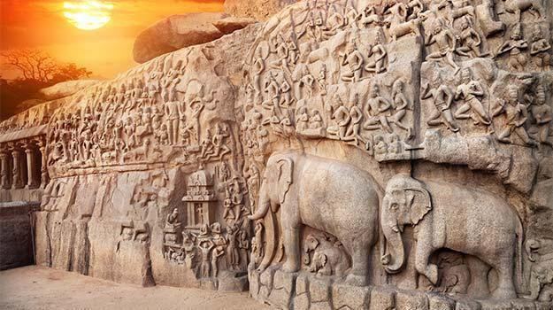
Example 2
Hindu temple in India
Summarize what the document is portraying in 1 sentence.
Then identify:
  S - Who is the speaker/artist?
  O – What is the occasion in which this was written/drawn?
  A – Who is the audience?
  P – What is the purpose of the document?

Slide 10
Sample Answers
S: Stone-cutters, most likely commissioned by Brahmin
O: Hindu religion has spread throughout India by this time
A: Illiterate population
P: Illustrate stories of Hinduism, glorify the religion
So…. Summary + SOAP
The rock carving from Mahabalipuram depicts a scene featuring many Hindu deities. The carving was created by stone-cutters in India, most likely commissioned by Brahmin, at a time when the Hindu religion had spread throughout India and most of the population was illiterate. The work is designed to illustrate stories of the Hindu religion, and to glorify the religion.

Slide 11
Example 3
Sima Qian, historian of the Han 2nd century BCE, from his book The Annals of Qin – an account of the first emperor of the earlier Qin dynasty.
“When the august [wise] Emperor came to the throne, he created regulations and made the laws intelligent, and his subjects cherished his instructions. In the 26th year of his rule, he, for the first time, unified all under Heaven, and there were none who did not submit.”
Summarize what the document is saying in 1 sentence. Do not quote.
Then identify:
  S - Who is the speaker/artist?
  O – What is the occasion in which this was written/drawn?
  A – Who is the audience?
  P – What is the purpose of the document?

Slide 12
Sample Answers
S: historian, Confucian, educated, elite
O: shortly after the Qin dynasty
A: ruling elite
P: justify/provide legitimacy for the Han Dynasty
So…Summary + SOAP
Sima Qian explains how the previous Qin emperor used laws to unify China. Sima Qian is a court-appointed historian of a powerful early Chinese dynasty, who writes in a period when China is reestablishing cohesion after a period of chaos. He directs his words at the bureaucrats and men in power to convince them of the importance of unity and regulations.

Slide 13
Example 4
Plato, Greek philosopher, student of Socrates, from his book Republic, written 360 BCE.
“Until philosophers rule as kings or those who are now called kings…that is, until political power and philosophy entirely coincide…cities will have no rest from evils…nor, I think, will the human race.”
Summarize what the document is saying in 1 sentence. Do not quote.
Then identify:
  S - Who is the speaker/artist?
  O – What is the occasion in which this was written/drawn?
  A – Who is the audience?
  P – What is the purpose of the document?

Slide 14
Sample Answer
S: philosopher, citizen of Athens, educated, elite
O: Athens, a city-state during a period of rivalry
A: educated people, students
P: wants a strong Athens and is looking for an answer
So…Summary + SOAP
Plato states that philosophers would make the best leaders. He is an educated philosopher in the city-state of Athens during the Classical Age, when there was much questioning concerning government. He directs his words at his students and other educated thinkers because he wants his own city-state to become dominant and successful in the Greek region.

Slide 15
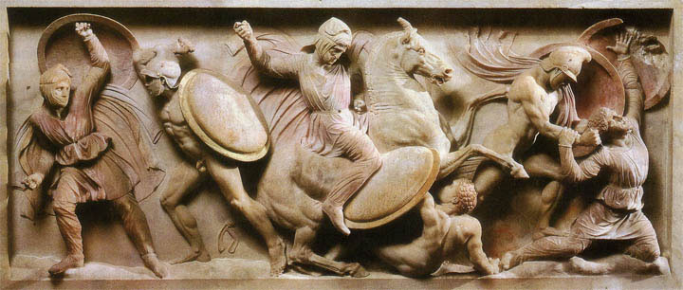
Example 5
Alexander the Great’s Sarcophagus
Summarize what the document is portraying in 1 sentence.
Then identify:
  S - Who is the speaker/artist?
  O – What is the occasion in which this was written/drawn?
  A – Who is the audience?
  P – What is the purpose of the document?

Slide 16
Sample Answer
S: sculptors, most likely commissioned by high-ranking members of the Seleucid government
O: Hellenistic Age, Alexander had spread Greek culture across West Asia
A: the public, those who visited Alexander’s mausoleum
P: to glorify Alexander and his army
So…. Summary + SOAP
Alexander’s Sarcophagus features a battle scene where Alexander and his soldiers are depicted as triumphing over their enemy. The sculpture was created by sculptors, most likely commissioned by high-ranking members of the Seleucid government after Alexander’s death during the Hellenistic Age, which spread Greek culture across West Asia. It was designed to glorify the actions of Alexander and his conquering forces to all who visited his mausoleum.

Slide 17
Example 6
Xun Kuang (Xun Zi), Chinese Confucian philosopher during the Warring States Period, 250 BCE
“People are born with natural tendencies toward “waywardness”: that is, a taste for profit and beauty and a susceptibility to jealousy and hate, all of which, if indulged in, would lead to disorder and criminality. In order to attain a oneness with the Way, and a dedication to morality, one needs the guidance of a proper teacher: only this would allow one to become morally upright. A proper teacher would have been trained in the teachings of the ancient sage kings who saw that human nature was inherently immoral and thus wrong. From this realization, the sage kings developed rituals and regulations to shape people toward morality.”
Summarize what the document is saying in 1 sentence. Do not quote.
Then identify:
  S - Who is the speaker/artist?
  O – What is the occasion in which this was written/drawn?
  A – Who is the audience?
  P – What is the purpose of the document?

Slide 18
Sample Answer
S: philosopher, legalist
O: Warring States Period, a time of chaos
A: Chinese people, elite
P: to explain problems with society and give one way to bring order, strict teachers
So…Summary + SOAP
In document __, Xun Kuang says that people are naturally bad and need strict rules in order to function in society. Xun Kuang was a Confucian philosopher, believing in the importance of respect and order in society, at a time when China was in chaos after the fall of the Zhou dynasty. He addresses philosophical and political leaders in an attempt to convince them to treat the populace harshly in order to stabilize society.

